Slide 1
Advanced SEND EMD Protocol

Slide 2
SEND
Secondary Emergency Notification of Dispatch

Slide 3
Requirements to use Protocol 38
Requires a level of trust- the agency / Medical Control agree that a field responder on scene can reliably recognize serious and minor injuries, priority symptoms, and the necessity of a lights-and-siren response.
All EMDs & field responders must complete training before using Protocol 38

Slide 4
Medical Dispatch should always try to obtain complete information.
Even if field responder personnel initially request “paramedics,” response should be driven by specific priority problems.
Priority Symptoms:
Abnormal Breathing
Decreased Level of Conscious
Chest Pain
Serious Hemorrhage

Slide 5
Field Responder Request for Medical Response
Even if a field responder initially requests an ambulance or paramedics, response should be driven by specific priority problems/incident types. The EMD should always try to obtain complete information.
The EMD will utilize MPDS Protocol 38: Advanced SEND (Medical Miranda) to gather information from the field responder to reach a determinant code, and thus a medical response priority level, to facilitate appropriate dispatch of EMS and MFRs.
Exceptions:
If choking is the Chief Complaint from the officer, go directly to Protocol 11: Choking to complete the interrogation.
If the officer reports a MAJOR INCIDENT or HIGH MECHANISM traffic situation, go directly to Protocol 29: Traffic Collision/Transportation Incident to complete the interrogation.
Notes:
MAJOR INCIDENTS: Defined by the MPDS as Transportation Incidents with evidence to suggest serious injuries to multiple patients or a need for increased resources due to the size of the event. Includes incidents involving aircraft; bus; multi-vehicle (≥10) pile-up; train; vehicle vs. building; or watercraft.
HIGH MECHANISM: Defined by the MPDS as Transportation Incidents with evidence to suggest serious injuries as a result of the mechanism of injury: all-terrain/snowmobile; auto vs. bicycle/auto vs. motorcycle; auto vs. pedestrian; ejection; personal watercraft; possible death at scene; rollovers; sinking vehicle; train vs. pedestrian; or vehicle off bridge/height.

Slide 6
Information to be obtained:
The problem category:
Injuries (TRAUMA)
Bleeding (TRAUMA)
MEDICAL
Bleeding (non-traumatic)
Traffic/Transportation Incident
SEVERE AGITATION/ACUTE BEHAVIORAL EVENT
Tasered
Aerosol/Mace exposure
Unknown (TRAUMA or MEDICAL)

Slide 7
Information to be obtained:
The type of injuries/incident (if the problem category is Injuries (TRAUMA), MEDICAL, or Traffic/Transportation Incident)
If the patient is responding normally (completely alert)
If the patient is in protective custody now (if the problem category is SEVERE AGITATION/ACUTE BEHAVIORAL EVENT, Tasered, or Aerosol/Mace exposure)

Slide 8
Information to be obtained:
If the patient is having difficulty breathing
If there is any SERIOUS bleeding
Recording if the field responder requested a specific response mode and which one (HOT (lights-and-siren) or COLD (routine))

Slide 9
“Hot” / ”Cold” Response:
Given the critical nature of any call, a field responder requested “COLD” (no lights and siren) response can be overridden by the EMD. The EMD will make a special note in the text of the case explaining their rationale for the override. This information shall be passed on to the EMS and MFRs by the telecommunicator.

Slide 10
Post-Dispatch Instructions (PDIs) & Pre-Arrival Instructions (PAIs)
Because field responders are trained in first aid and life-saving measures, the EMD should only provide instructions labeled as “(Officer requests)” if the field responder asks what to do.
The EMD can provide PAIs for patient care if requested by the field responder on scene. Links to a variety of PAIs to assist the field responder are available on the right of the PDI/CEI tab and through the Target Tool.
Notes:
When using P11: Choking, the PDIs of “EMS notified” and “(PAIs possible) Would you like further instructions on (how to perform the Heimlich/CPR)?” and (if not providing PAIs) “Notify us if anything changes” should be given.
When using P29: Traffic Collision/Transportation Incident, the PDIs of “EMS notified” and “Notify us if anything changes” should be given.

Slide 11

https://www.prioritydispatch.net/en/advanced-send-training

Slide 12
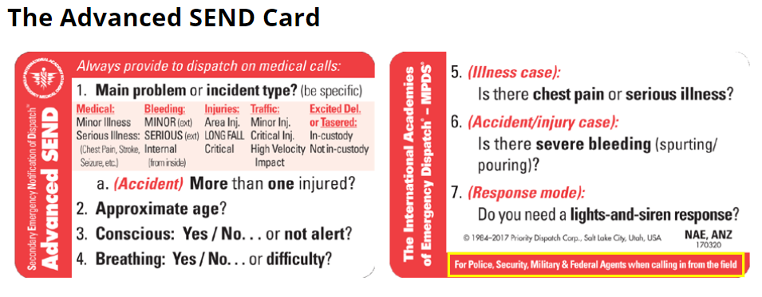

Slide 13
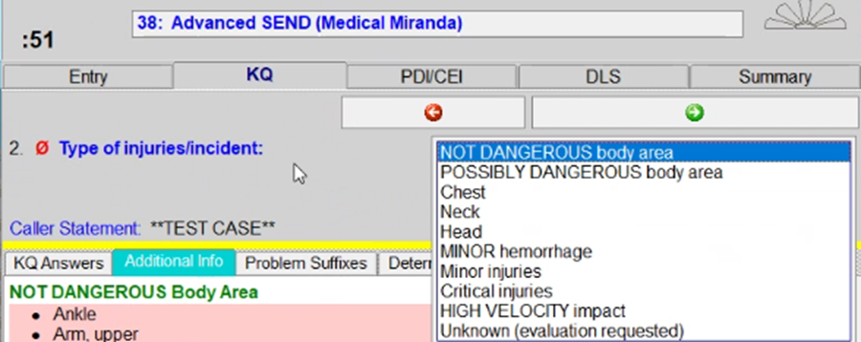

3. Responding normally?
4. Difficulty breathing?
5. Serious bleeding?

Slide 14
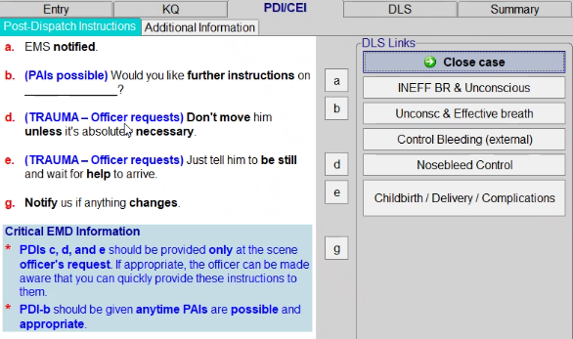
Dispatchers can provide Pre-Arrival Instructions (PAIs) for patient care if requested by the officer on scene.

Slide 15
In general, if a requesting field responder is using the Advanced SEND card, Protocol 38 is the appropriate protocol to use, with the exception of incidents where is the patient is choking and MAJOR INCIDENTs or HIGH MECHANISM traffic situations.

Slide 16


